Slide 1
Research Data Management at Leicester
Dr Jonathan Tedds
University of Leicester
Senior Research Liaison Manager
IT Services
Research Fellow
Dept of Physics & Astronomy
twitter @jtedds
jat26@le.ac.uk

Slide 2
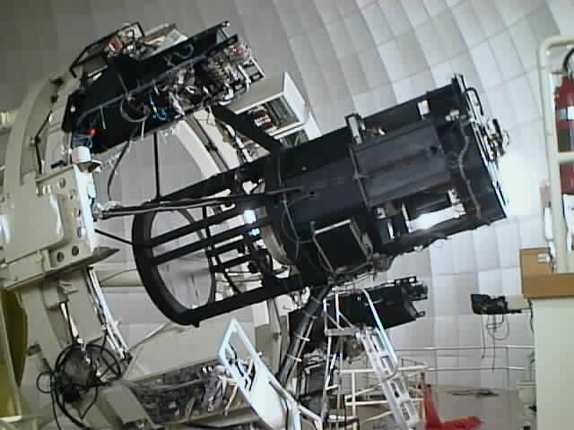
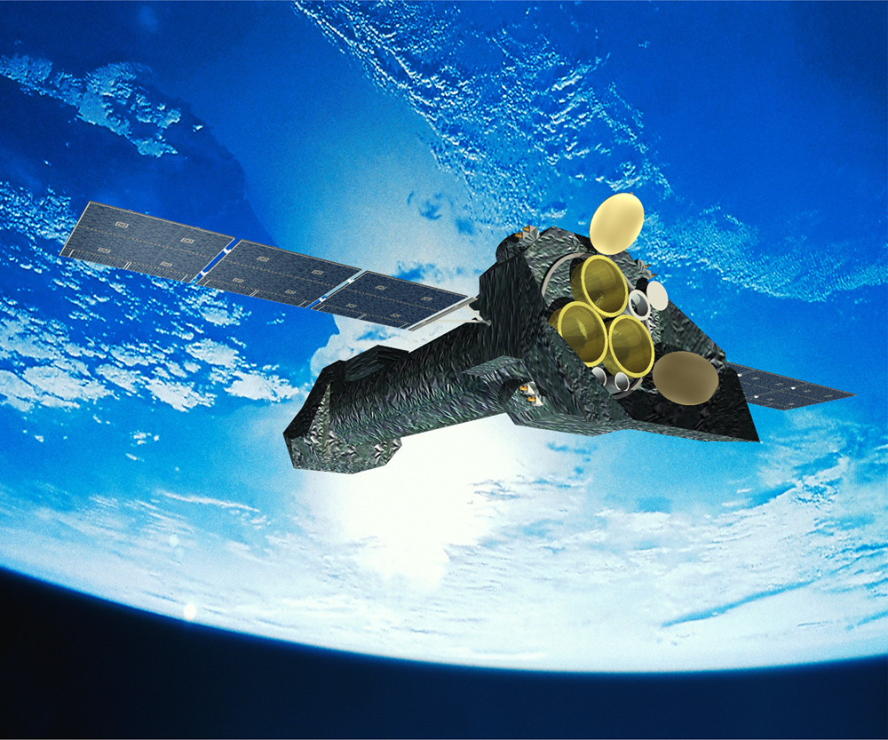
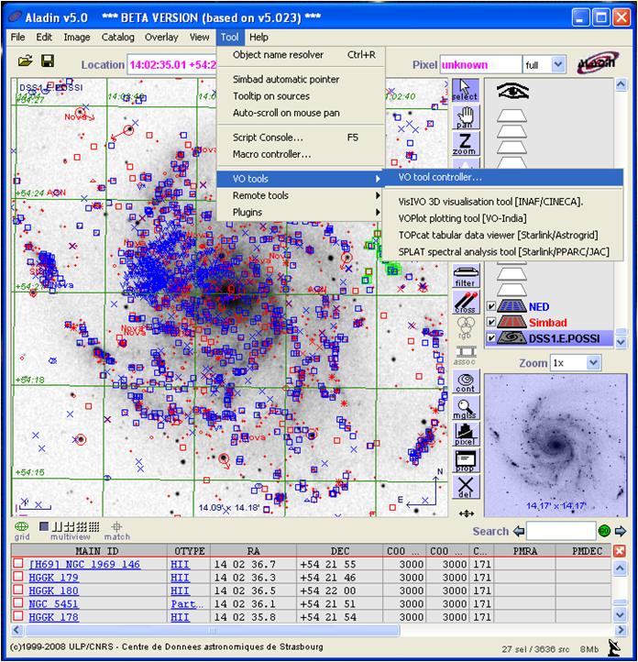
http://www.astrogrid.org
(April 2008 1st public release)

Slide 3
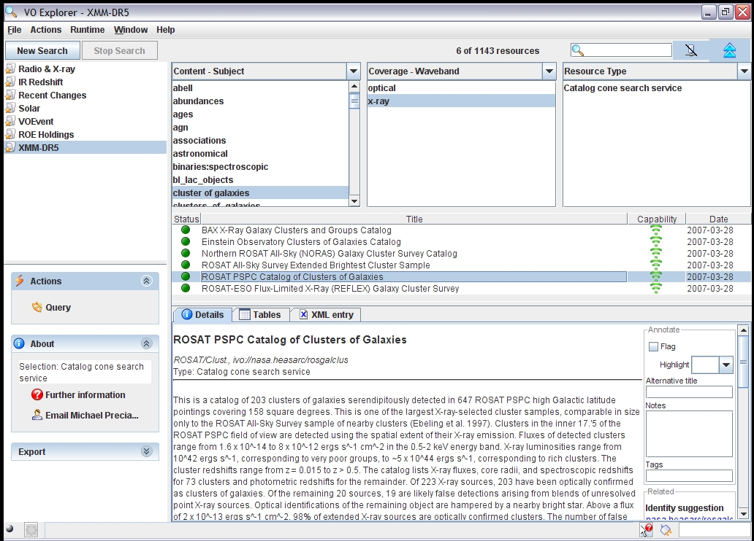
http://www.astrogrid.org
AstroGrid front end, part of VOdesktop
Resource-centric
Select a search-space
Search for resources
Filter these resources
View selected resources
Use the selection
Invoke it
Save/Bookmark/Tag it
Export it

Slide 4
UK Research Data Service (UKRDS) pathfinder
Key finding of HEFCE funded study 2008/9 at Leicester, Oxford, Bristol, Leeds:
research facilitators = missing link
initial funding from Oct 09 + need institutional level support
Coordinate research life cycle, expertise & training across key institutional stakeholders
Researchers in Colleges, depts, groups, projects
IT Services – embryonic research computing support – HPC, storage….
Research Support Office – funding, legal requirements…
Library - repository archive, ethical & training expertise…
Coordinate to national expertise including
JISC Managing Research Data program #jiscmrd
Digital Curation Centre – research data management planning tools
RCUK & EU FP6,7 e-science program, RIN, OMII, UCISA…..

Slide 5
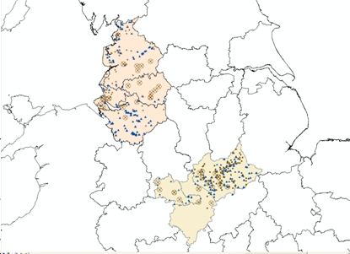
HALOGEN (History, Archaeology, Linguistics, Onomastics, GENetics): Throwing light on the past through cross-disciplinary databasing
Portable Antiquities Scheme (British Museum)
Place-names (Nottingham)
Surnames
Genetics
IT hosting and GIS
Best practice:
#JISCMRD, UKRDS, DCC, international
http://halogen.le.ac.uk

Slide 6
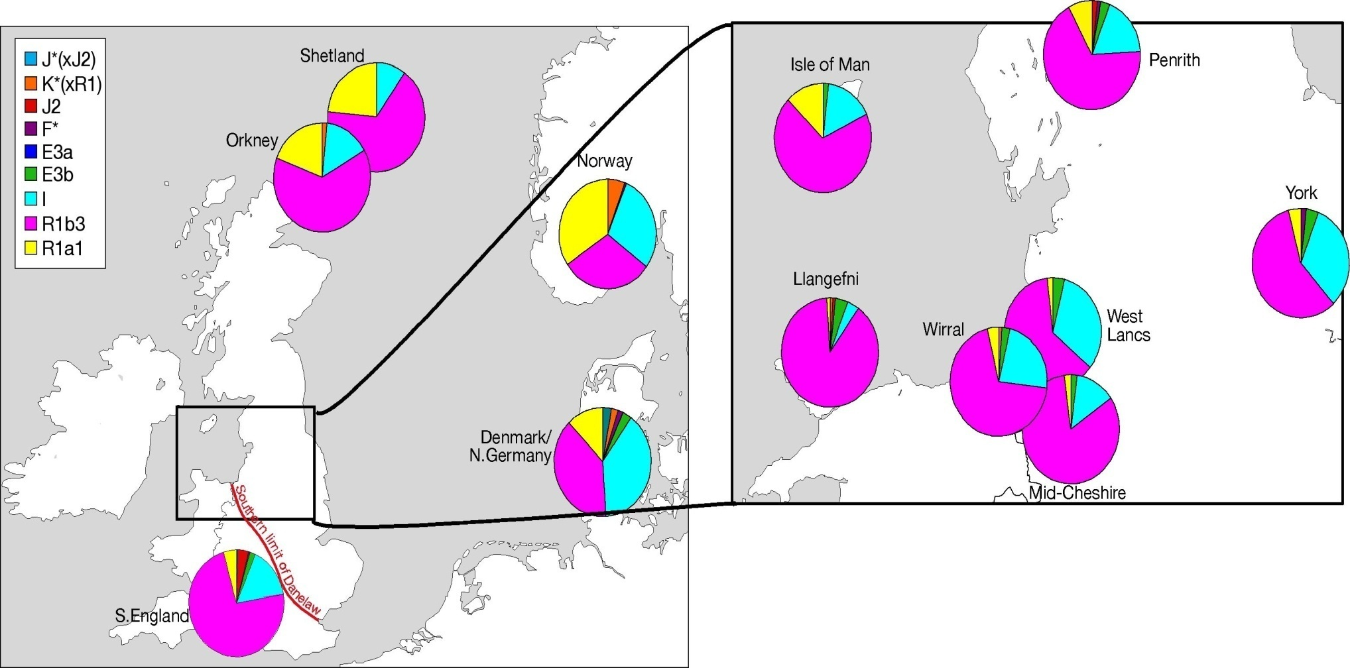
Genetic variation (Y data)
Bowden et al., 2008
p=0.006
p=0.026
Population differentiation test

Slide 7
Halogen as template for research data management #jiscmrd
Requirements Analysis – must be iterative!
Data Management Plan – use DMPonline (DCC)
Scalable research data management infrastructure
pilot phase to nationally available resource
LAMP stack IT infrastructure: host research database – work with JISC/DCC
A model for the long term delivery of a data management service within the institution including
support, maintenance, governance & charging policies
Include researchers, IT services, research support office, library services

Slide 8
Halogen output
combines input datasets via Geographical Information Systems (GIS):
linguistics
archaeology
genetics
=> #JISCgeo programme

Slide 12
Challenges
interdisciplinary research database
ingest each input dataset in form such that sufficient information is carried forward to enable interoperation
Cultural differences
versioning & provenance for input datasets
which software tools, infrastructure , Query interface?
suitable for multi disciplinary researchers
Requirements upon the institution for sustaining the research assets
Requirements upon the researchers
Annotating
Refreshing
Maintainence of datasets

Slide 13
Direct Benefits
New research opportunities
Cross database work – seed new research samples
Scholarly communication/access to national resources
Key to English Place Names (Nottingham)
Portable Antiquities Scheme (British Museum)
Verification, re-purposing, re-use of data
Cleaning & enhancing private research datasets for reuse & correlation
Increased transparency
excellent training for best practice in research data management
Increasing research productivity
Build in cleaning, annotation, enhancement into normal research workflows
research datasets may immediately be reusable and interoperable
Impact & Knowledge Transfer
Reuse IT infrastructure: EU FP7 Mintweld (industrial engineering) & BRICCS National Health Service/University Trust data sharing.
Increasing skills base of researchers/students/staff

Slide 14
Reward = Leverhulme Trust funding £1.3m!

Slide 15
Indirect Benefits (Costs Avoided)
No re-creation of data
Researchers avoid valuable time needed to transcribe external data sources
Inter disciplinary research platform available centrally for reuse as a service
Lower future preservation costs
Reusable Service Level Agreements in place
Not dependent on individuals alone
Re-purposing data, methodologies for new audiences
Internal & national research resources can become nationally reusable
e.g. Geneticists learn better spatial correlation analysis techniques
Protecting returns on earlier investments
research funders: Wellcome Trust, Leverhulme Trust, AHRC, British Museum
Institutions: Universities of Leicester, Nottingham, UCL

Slide 16
Biomedical Research Infrastructure Software Service: BRISSkit
http://www.le.ac.uk/brisskit
JISC University Modernisation Fund 2011/12
UoL ITS-RCS, Cardiovascular, Genetics & Health Sciences + UHL Trust
develop national shared service in cloud with Eduserv on VMware
brokered by JANET
host, implement, deploy biomedical research database applications
Remove duplication of highly skilled development effort via
Design from scratch
Buy & administer
developed prototype open source IT infrastructure for the Biomedical Research Informatics Centre for Cardiovascular Science in the NIHR Leicester Cardiovascular Biomedical Research Unit
Anonymised versions of patient sensitive databases are hosted for University researchers on LAMP VMware platform implemented by Research Computing Service in IT Services

Slide 17
Universities and their users
http://www.le.ac.uk/brisskit
Advice and requirements response
Brokerage and Strategic Support
JANET(UK)
DCC
Others e.g. HPC
Service delivery
and support
Service delivery
and support
http://www.janetbrokerage.ac.uk/
SLAs Ts and Cs
Compliance monitoring
http://umfcloudpilot.eduserv.org.uk
Cloud Storage Providers
Other Cloud Infrastructure
XaaS

Slide 18
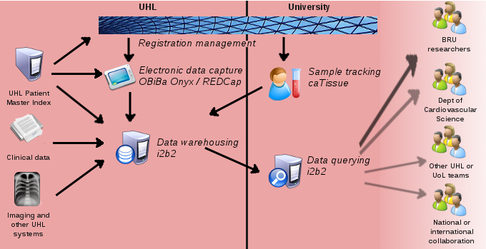
BRISSkit: Biomedical Research Infrastructure Software Service kit
Electronic Data Capture / questionnaire – OBiBa Onyx / REDcap
Specimen Inventory / sample tracking – caTissue
Cohort selection and data querying - i2b2

Slide 19
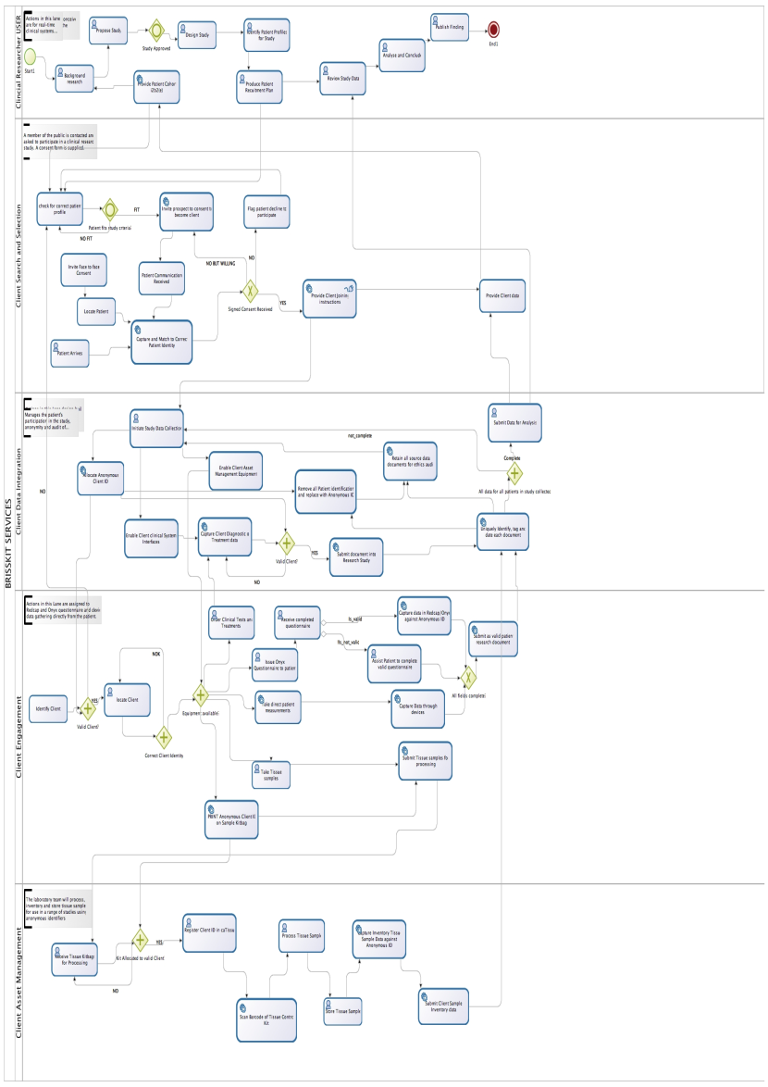
Service Options
Client Data Analytics (i2b2)
Client Search, Selection and Registration (C3PR+)
Client Data Integration and Audit (XDS)
Client Engagement (Onyx)
Client Asset Management (caTissue)
PROCESSES
Notes:
We examined a number of Commercial, Off The Shelf products in various fields: laboratory management, clinical trials management, databases, and so on. None of them quite met our requirements, and none inspired us with their approach to solving the translational research problems. We recognised that we lacked the necessary resources to develop in-house a platform of sufficient scale in the timetable of the BRU’s funding. So we looked at research centres who had tackled similar issues by developing their own tools and making them available via Free and Open Source licenses.
The vision for BRICCS has grown while we worked – not unusual in software development projects, as we've identified areas of the BRU's work where automation, integration and flexible data management would be useful.

Slide 20
BRISSkit Sustainability – OS engagement
OS community engagement
standards compliance
service vision
Cross-enterprise Service Architecture:
how to join & use service for new groups & partners
Definition of service vision, organisational & service components
all relevant standards & tools which Brisskit partners will be expected to use and comply with
OS Community Engagement Charter
defining engagement with existing & new OS communities
including adoption & code commitments
Notes:
As a survey of the current state of open source research tools, there are five large scale projects which might be appropriate for biorepositories or research institutions to explore. And three projects which individual researchers might find helpful right now on their desktops. This isn’t a sales pitch, but I’d be surprised if there was anyone in the room who wouldn’t find something to interest them in one or other of the illustrated programs.
Following the maxim that open source software seeks to do one thing well, we have deployed at Leicester tools from both the caBIG suite and the OBiBa consortium, we have researchers and staff using Mendeley, and a plan to install i2b2 as the hub for integrating clinical data with our research data. It’s a pick-and-mix approach to research informatics.

Slide 21
BRISSkit – meeting a challenge?
Is there value in delivering cloud-based applications as a service to researchers?
Ease of deployment, administration and archiving
Cost of computing can be scaled to projects
Model lends itself to distributed projects and teams
Infrastructure can be geared to integration
Enhanced basis for data sharing and federation
Need to ensure sustainability of the service
Confidentiality and governance
http://www.le.ac.uk/BRISSkit

Slide 22
Organisational Challenges and Solutions
Cultural differences
Recognise different cultures and mind sets
research community and IT specialists in central services
different professional language, expectations and working practises
management of a research project usually requires a different, iterative methodology than an IT infrastructure project having a more clearly pre determined end point
Research Liaison Role
strong research background helps!
enables effective ways of liaising with research community
bridging gaps in understanding
Leveraging expertise within and external to the organisation
coordinate ‘specialists’
See Research Fortnight blog piece Feb 2011

Slide 23
Top Tip: how to get researchers’ attention?
Research grant pre-award costing (LUCRE - SAP based)
Dominates researchers’ minds!
Enable PIs to build grant application using actual costs of staff, overheads, and the right rules for funder
Trigger involvement of IT Research Liaison and wider institutional expertise via flags
sensitive research data
costing/planning support including curation and preservation over research lifecycle
Track institution wide needs via IT Service Desk

Slide 24
Add governance....
Governance
Information and Communications Technology Committee
IT Portfolio Board
IT Management Groups for Corporate Services (10 in total)
Academic Policy Committee
Research Policy Committee
Learning Technologies Management Group
Research Computing Management Group
University Policy and Strategy
Information Security Policy Working Group
JISCMRD policy event, 12-13 March, Leeds

Slide 25
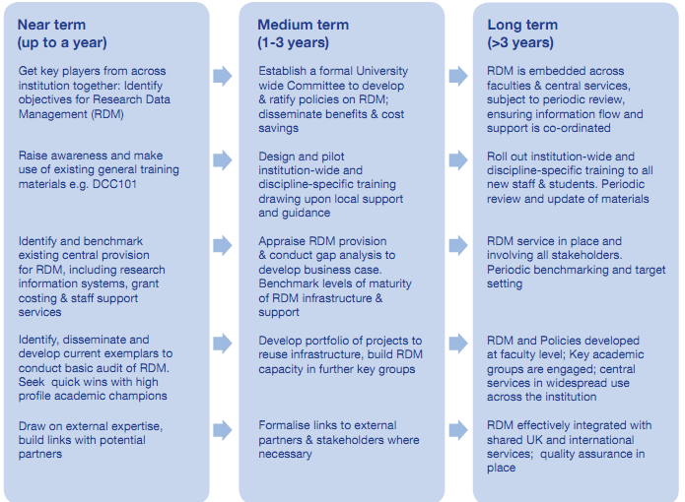
Suggested institutional timeline
From Whyte & Tedds (2011), DCC Briefing
http://www.dcc.ac.uk/resources/briefing-papers/making-case-rdm

Slide 27
Priorities for IT service enhancement and future investment in research computing
Storage & curation
Research data management & planning - including sensitive data
LINUX platform, LAMP stack database hosting
training
Performance
HPC on demand, network fit for purpose
Enable Collaboration
Internal/external (including non HEIs)
Across ITS, RSO, Library for researchers
Coordinate Expertise
Cross disciplinary - Halogen (GIS), BRICCS (astronomy e-science)
Grant bidding - IT costing & support
Best practice (JISC, DCC, UKDA..international)

Slide 28
